Slide 1

Arrays
An array collects a set of values of the same type.
To declare an array variable of type double[]
double[] values;
To initialize the array variable with the array:
double[] values = new double[10];
By default, each number in the array is 0
You can specify the initial values when you create the array
double[] moreValues = { 32, 54, 67.5, 29, 35, 80, 115, 44.5, 100, 65 };

Slide 2
Arrays
To access a value in an array, specify which position you want to use
use the [] operator
values[4] = 35;
The position number is called an index.
Each position contains an element.
Individual elements are accessed by an integer index, such as i, using the notation array[i].
An array element can be used like any variable.
System.out.println(values[4]);

Slide 3
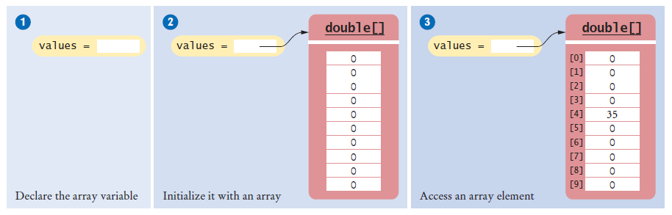
Arrays
double[] values; values = new double[10]; values[4] = 35;
Figure 1 An Array of Size 10

Slide 4
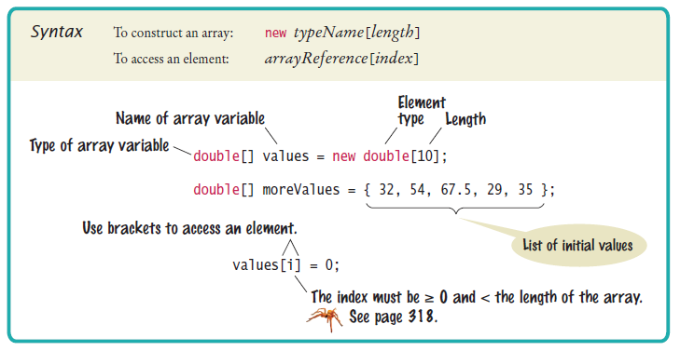
Syntax 7.1 Arrays

Slide 5
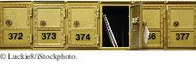
Arrays
The elements of arrays are numbered starting at 0.
Just like String class…
The following declaration creates an array of 10 elements:
double[] values = new double[10];
An index can be any integer ranging from 0 to 9.
The first element is values[0]
The last element is values[9]
Like a mailbox that is identified by a box number, an array element is identified by an index.

Slide 6
Arrays – Bounds Error
A bounds error occurs if you supply an invalid array index.
Causes your program to terminate with a run-time error.
Example:
double[] values = new double[10];
values[10] = value; // Error
values.length yields the length of the values array.
There are no parentheses following length.

Slide 7
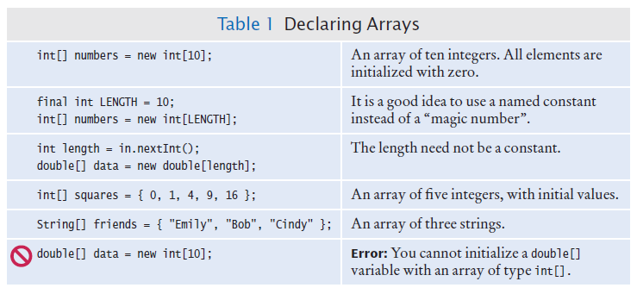
Declaring Arrays

Slide 8
Array References
An array reference specifies the location of an array.
Copying the reference yields a second reference to the same array.

Slide 9
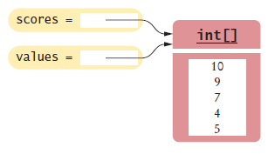
Array References
When you copy an array variable into another, both variables refer to the same array
int[] scores = { 10, 9, 7, 4, 5 };
int[] values = scores; // Copying array reference
You can modify the array through either of the variables:
scores[3] = 10;
System.out.println(values[3]); // Prints 10
Figure 2 Two Array Variables Referencing the Same Array

Slide 10
Using Arrays with Methods
Arrays can occur as method arguments and return values.
An array as a method argument
public void addScores(int[] values)
{
for (int i = 0; i < values.length; i++)
{
totalScore = totalScore + values[i];
}
}
To call this method
int[] scores = { 10, 9, 7, 10 };
fred.addScores(scores);
A method with an array return value
public int[] getScores()

Slide 11
Partially Filled Arrays
Array length = maximum number of elements in array.
Usually, array is partially filled
Define an array larger than you will need
final int LENGTH = 100;
double[] values = new double[LENGTH];
Use companion variable to keep track of current size: call it currentSize

Slide 12
Partially Filled Arrays
A loop to fill the array
int currentSize = 0;
Scanner in = new Scanner(System.in);
while (in.hasNextDouble())
{
if (currentSize < values.length)
{
values[currentSize] = in.nextDouble();
currentSize++;
}
}
At the end of the loop, currentSize contains the actual number of elements in the array.
Note: Stop accepting inputs when currentSize reaches the array length.

Slide 13
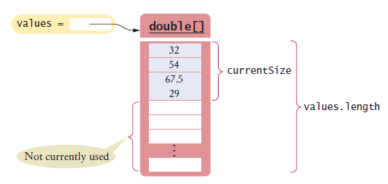
Partially Filled Arrays

Slide 14

Partially Filled Arrays
To process the gathered array elements, use the companion variable, not the array length:
for (int i = 0; i < currentSize; i++)
{
System.out.println(values[i]);
}
With a partially filled array, you need to remember how many elements are filled.

Slide 15
Self Check 7.1
Declare an array of integers containing the first five prime numbers.
Answer:
int[] primes = { 2, 3, 5, 7, 11 };

Slide 16
Self Check 7.2
Assume the array primes has been initialized as described in Self Check 1. What does it contain after executing the following loop? Trace Table Time!
for (int i = 0; i < 2; i++)
{
primes[4 - i] = primes[i];
}
Answer: 2, 3, 5, 3, 2

Slide 17
Self Check 7.3
Assume the array primes has been initialized as described in Self Check 1. What does it contain after executing the following loop? Trace Table Time!
for (int i = 0; i < 5; i++)
{
primes[i]++;
}
Answer: 3, 4, 6, 8, 12

Slide 18
Self Check 7.4
Given the declaration
int[] values = new int[10];
write statements to put the integer 10 into the elements of the array values with the lowest and the highest valid index.
Answer:
values[0] = 10;
values[9] = 10;

Slide 19
Self Check 7.5
Declare an array called words that can hold ten elements of type String.
Answer:
String[] words = new String[10];

Slide 20
Self Check 7.6
Declare an array containing two strings, "Yes", and "No".
Answer:
String[] words = { "Yes", "No" };

Slide 21
Self Check 7.8
Declare a method of a class Lottery that returns a combination of n numbers. You don’t need to implement the method.
Answer:
public class Lottery
{
public int[] getCombination(int n) { . . . }
. . .
}

Slide 22
If you didn’t hear a message: Upload: arrays are __________ fill in the blank for your opinion of arrays!

